Slide 1
William Daniels
Artist
LUHRING AUGUSTINE
http://www.luhringaugustine.com/artists/william-daniels

Slide 2
William Daniels is a young artist, born in 1976 in Brighton, England. Daneils uses oil paints on wood to create his trompe l’oeil styled art. Before making his art, inspired by famous historical paintings, he constructs models of what he wants to paint using common materials like tinfoil, paper and cardboard. Then he painstakingly recreates the look in oil paints.
Tromp l’oeil is a style of painting that gives the object depicted a detailed, realistic appearance.

Slide 3
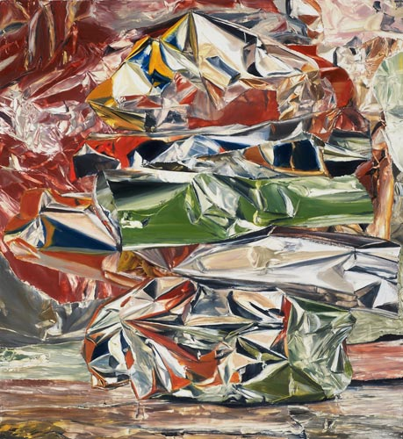

Slide 4
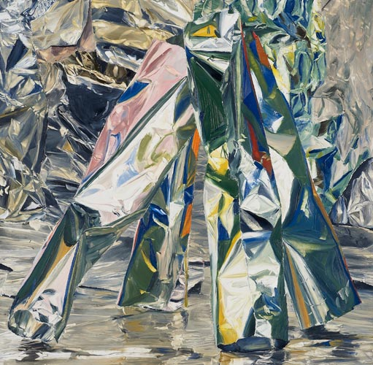

Slide 5
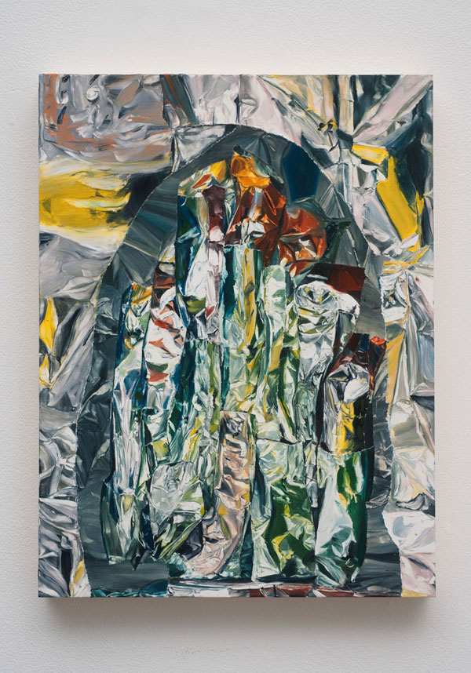

Slide 6
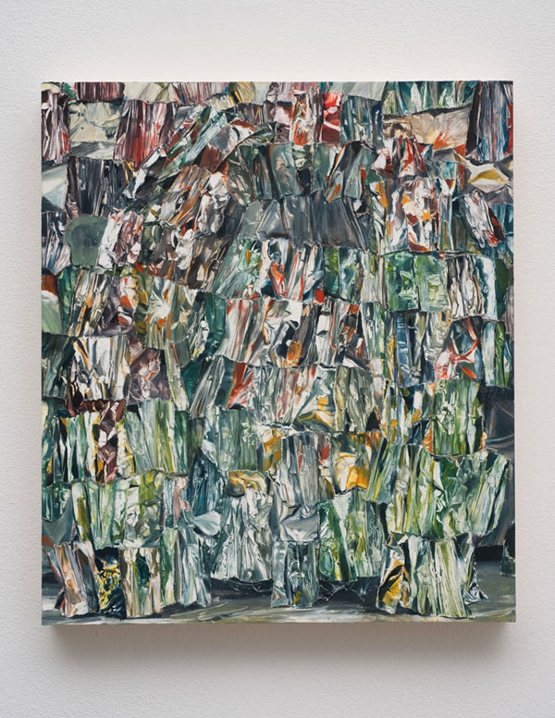

Slide 7
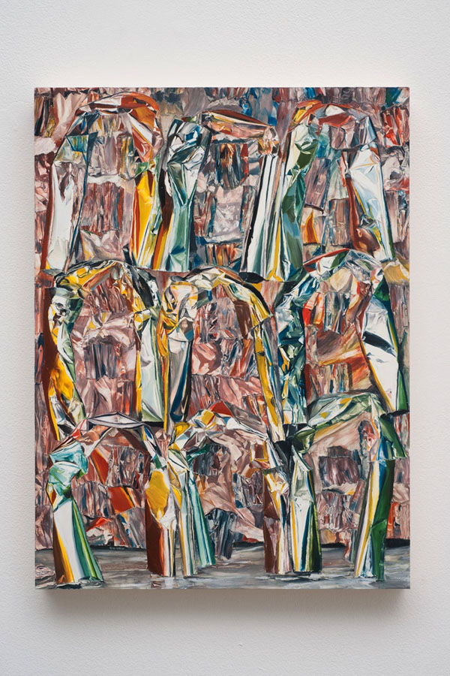

Slide 8
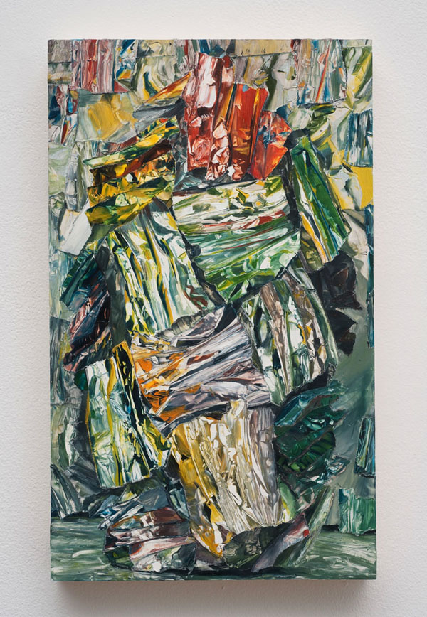

Slide 9
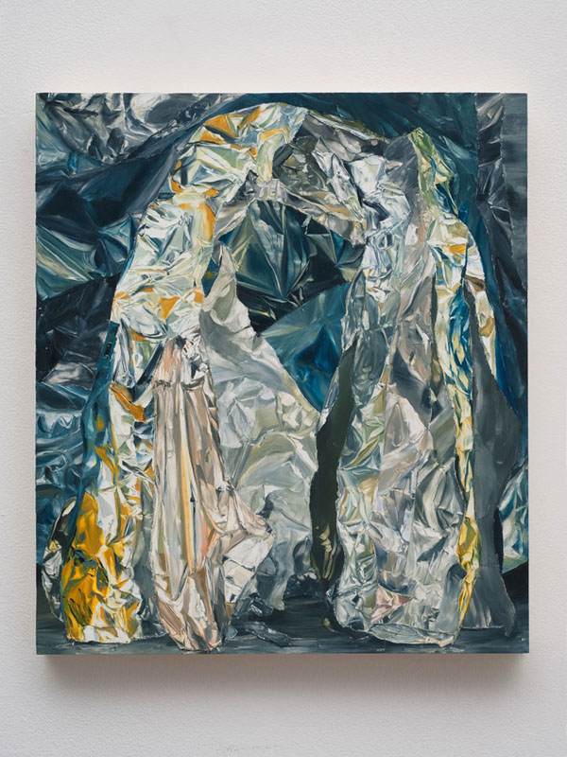

Slide 10
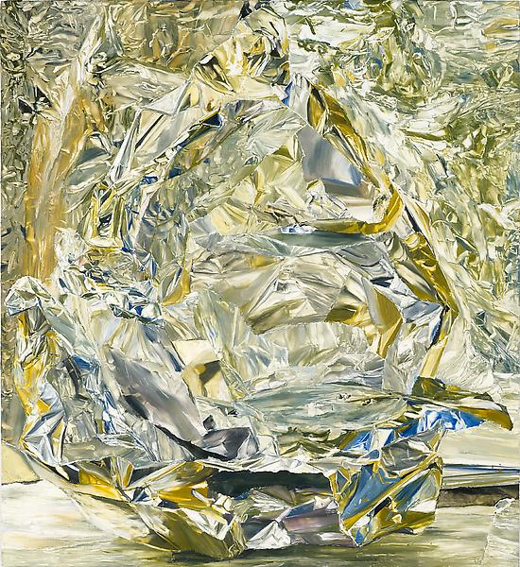

Slide 11
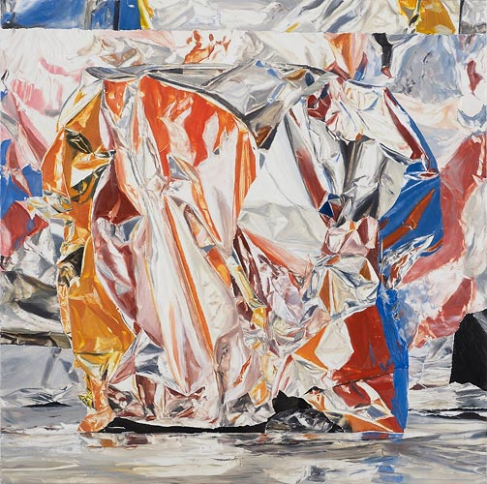

Slide 12
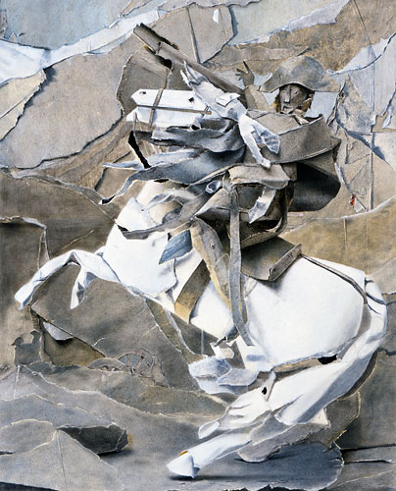

Slide 13
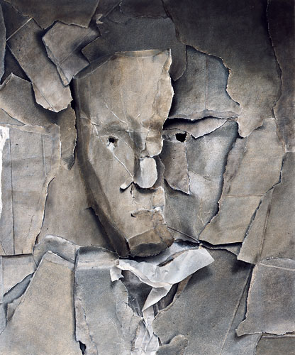

Slide 14
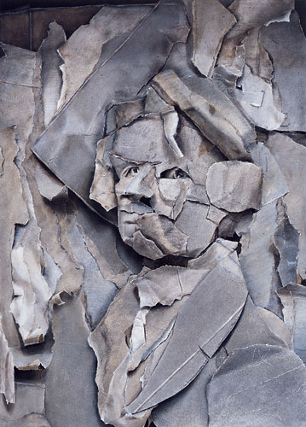

Slide 15
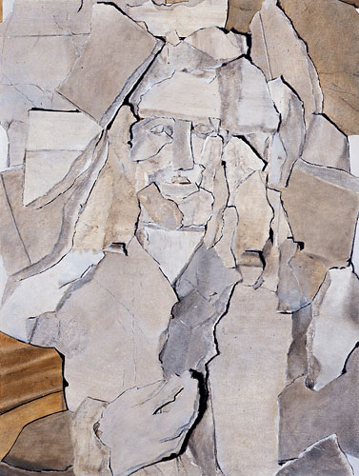

Slide 16
