Slide 1
Alberto Cerriterno
Mexican Artist
http://www.albertocerriteno.com/index.html

Slide 2
Alberto Cerriteño is a Mexican illustrator and designer who has lived in Portland, Oregon for nearly four years now. Strongly inspired by urban vinyl toys, alternative cartoons, and the pop surrealism movement, Alberto Cerriteño has developed his own very personal technique and style. You’ll notice delicate hints of traditional Mexican artistic influences in his use of rich textures and decorative patterns.

Slide 3

Notes:
The Enamored Owl

Slide 4

Notes:
The Enamored Snail

Slide 5
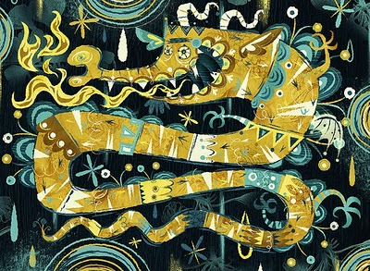
Notes:
The Power of Between

Slide 6
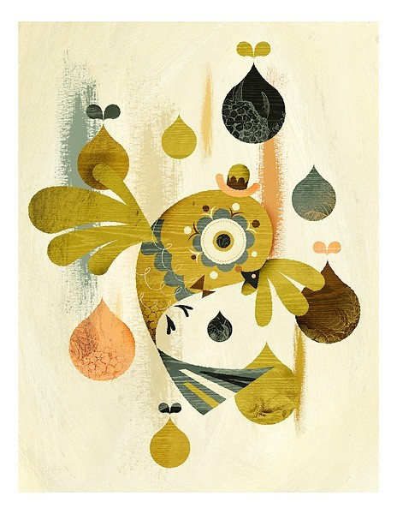
Notes:
Departing

Slide 7
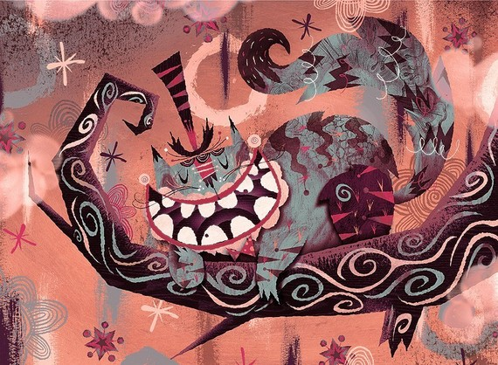
Notes:
A Charming Smile

Slide 8
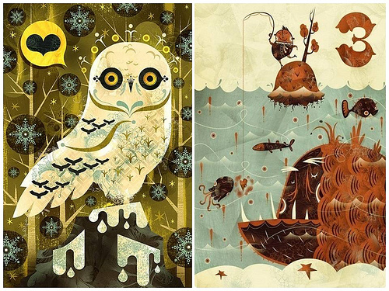
Notes:
Snowy Owl Tres

Slide 9

Notes:
The Enamored Whale

Slide 10
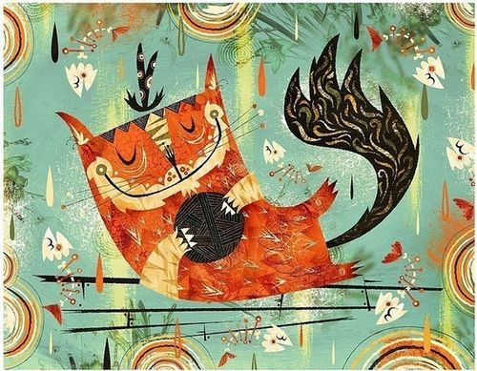
Notes:
Playtime

Slide 11
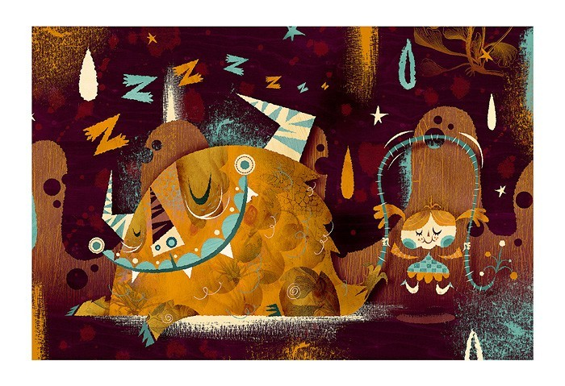
Notes:
The Gamble

Slide 12
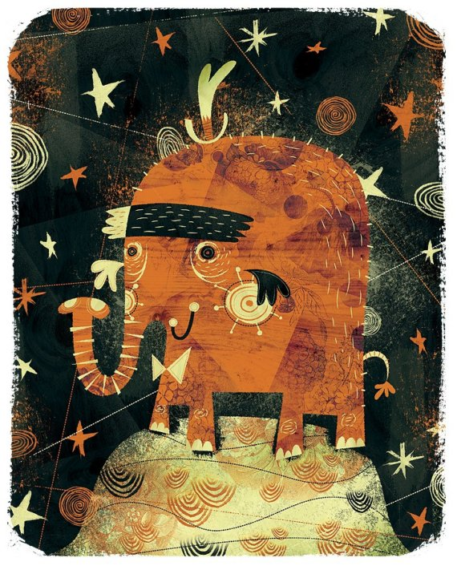
Notes:
Twenty Stars and One Hat

Slide 13
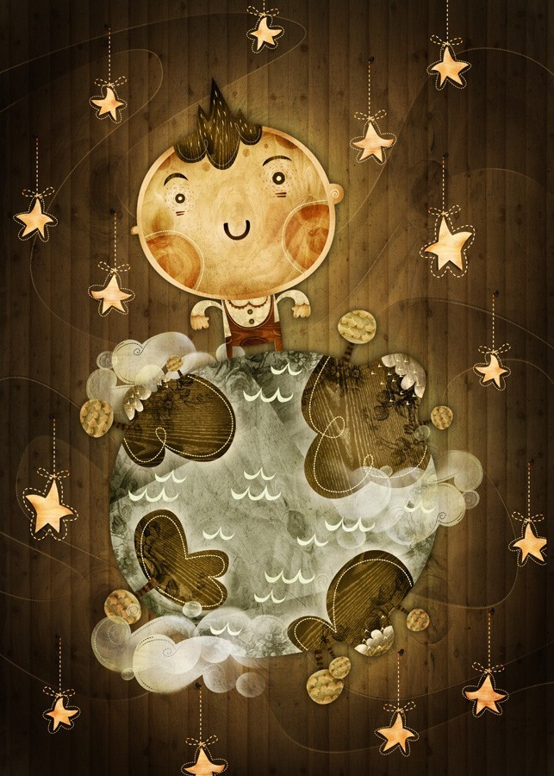
Notes:
Their World

Slide 14
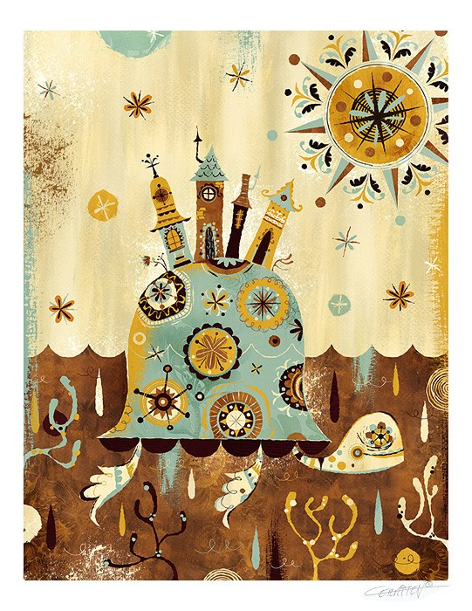
Notes:
The Tortoise’s Travels

Slide 15

Notes:
Three on Tree

Slide 16
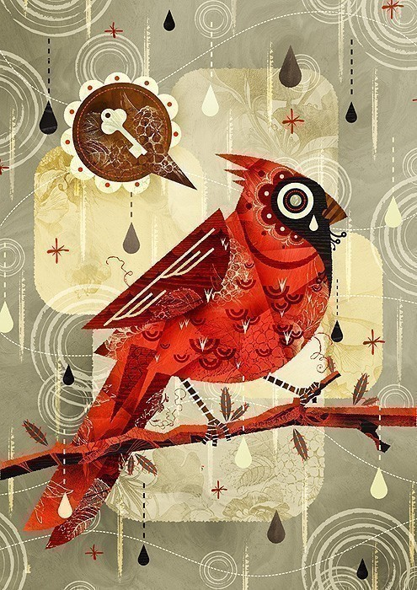
Notes:
Yearning for Freedom

Slide 17
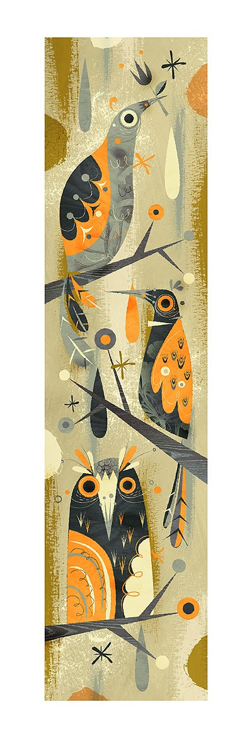
Notes:
Chattering

