Slide 1
Gaston Chaissac
Gaston said, “Without a doubt I have a soul that is very close to a circus performer, who, like me, hardly know how to write and am not instructed by what they see.”

Slide 2
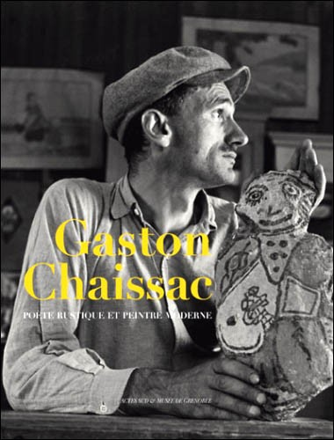

Slide 3
Gaston Chaissac was completely self taught, having never followed any artistic training. He painted on all sorts of meduim including cardboard, canvas, stone and sheet metal. He did not become famous until after his death.
His style is said to be Art Brut — which translates into English as "raw" or "rough" art — the first term used to describe outsider art.
"Outsider Art is often created by self-taught artists who are working outside the mainstream of the fine-art tradition," Colleene says. "When you're studying art history, you follow the line from the Renaissance, to the Mannerist, Baroque, and Rococo periods. These artists aren't looking at that structured progression of Western art history. They don't study Michelangelo or Da Vinci, or the other masters. Their work is the external manifestation of what's going on in and outside of their personal experience." "One of the most compelling parts of Outsider Art is the individual purity of it," Colleene says. "It hasn't been contaminated by what other people think is good or bad or what is the right color scheme.“
Excerpts taken from an article written by Dennis Gaffney in Inside "Outsider Art"

Slide 4
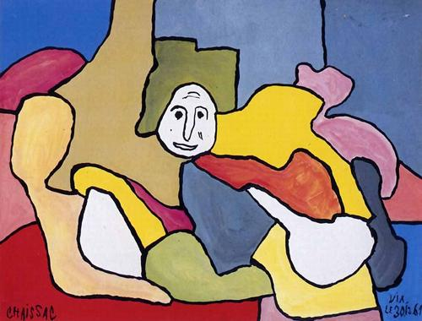

Slide 5
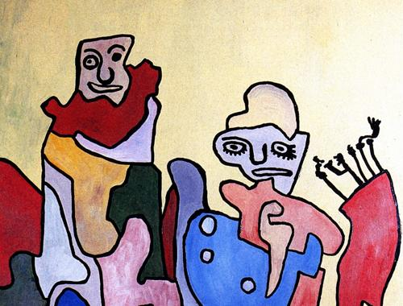

Slide 6
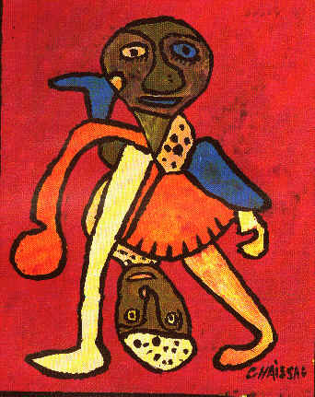

Slide 7
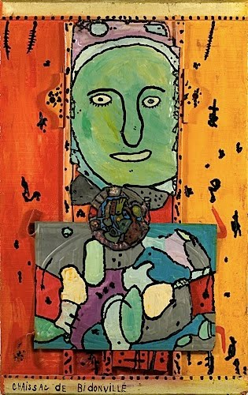

Slide 8
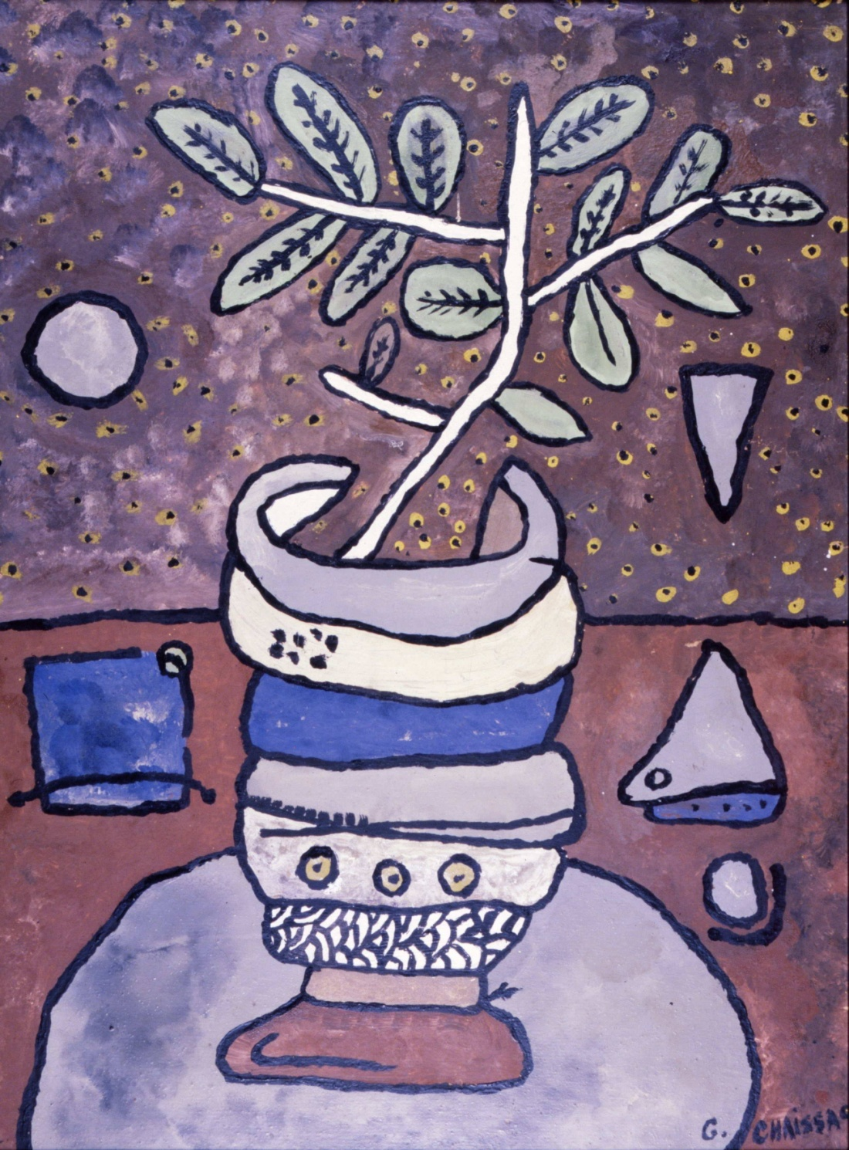

Slide 9
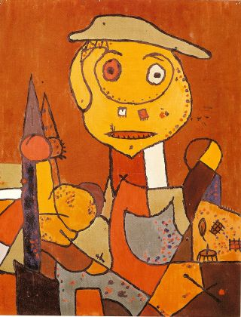

Slide 10
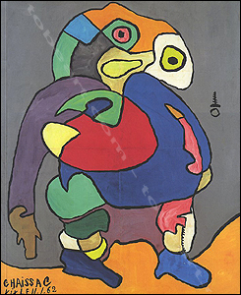

Slide 11
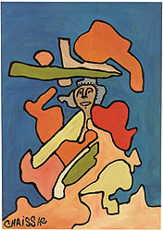

Slide 12
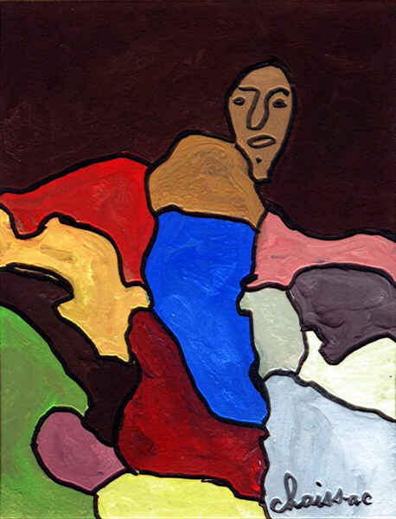

Slide 13
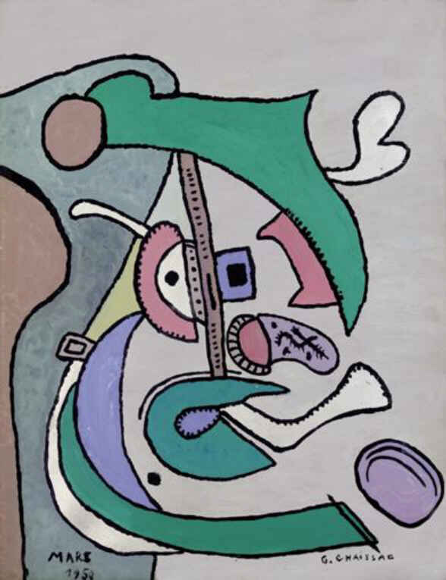

Slide 14
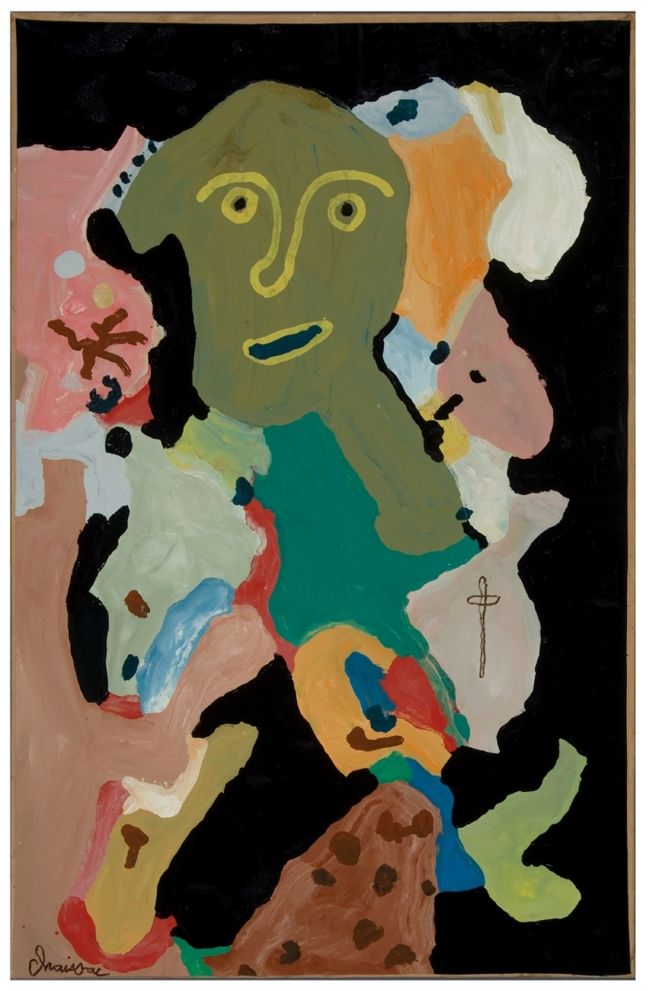

Slide 15
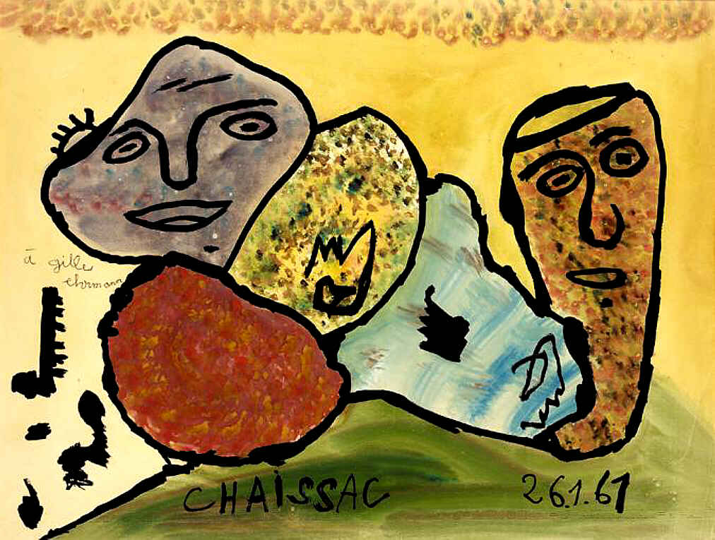

Slide 16
