Slide 1
Romero Britto
http://www.britto.com/front/biography

Slide 2
A modern day pop culture icon, Romero Britto is one of the premiere Pop Artists of our time. As the youngest and most successful pop artist of this generation, Britto has managed to create contemporary masterpieces that evoke a spirit of hope and convey a sense of warmth. His original artwork, dubbed the art of healing, brings together bright colors and playful
themes with compositional elements of cubism. Britto’s work provides art lovers around the world an open-minded and optimistic view of life, from the mental canvas of an artist who gains daily inspiration from the world around him.
The preceding is an excerpt from the website below:
http://www.brittotoursamerica.com/pdf/Romero-Britto-Bio.pdf

Slide 3
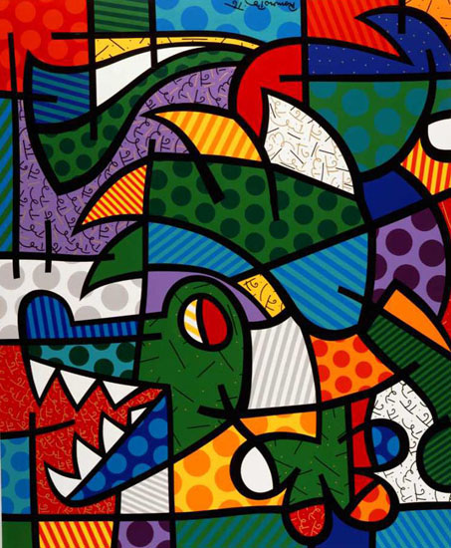

Slide 4
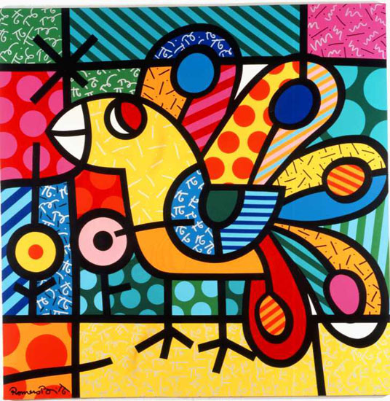

Slide 5
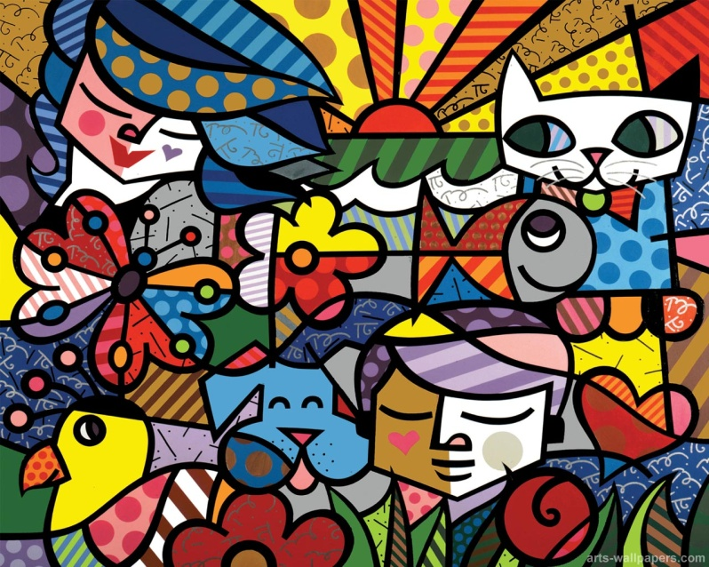

Slide 6
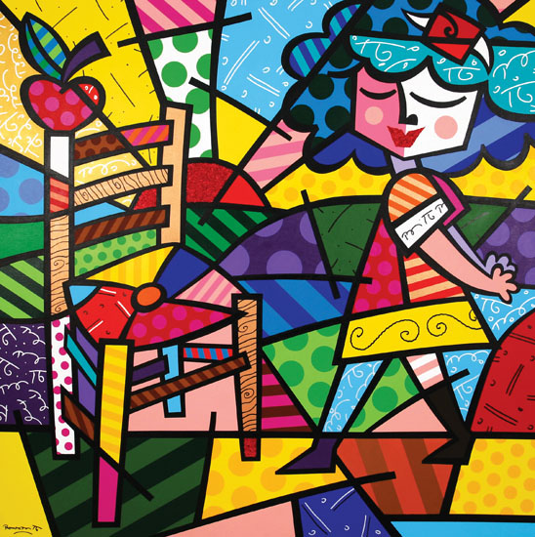

Slide 7
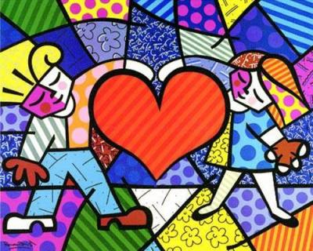

Slide 8
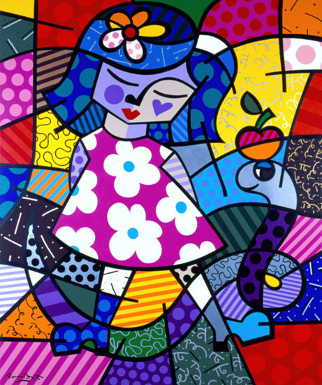

Slide 9
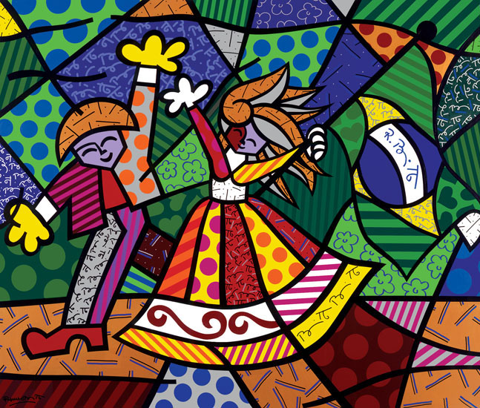

Slide 10
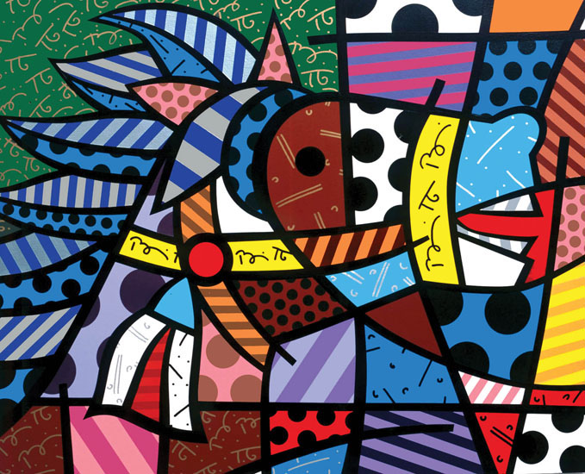

Slide 12
