Slide 1
PERUVIAN ARPILLERA
TEXTILE ART

Slide 2
Arpilleras are intricately detailed hand sewn textile pictures. Each piece illustrates some aspect of daily life for the women of the Andes. The arpillera, in an array of colors , tells the story of the country markets where locals come to buy vegetables, clothing and wool for weaving.

Slide 3
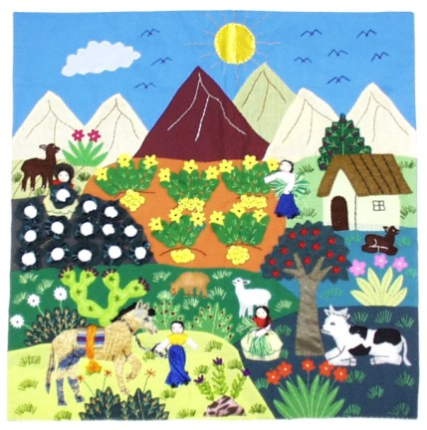
Notes:
Farm Life

Slide 4
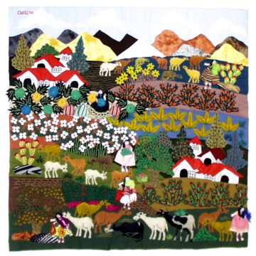
Notes:
Farm Life

Slide 5
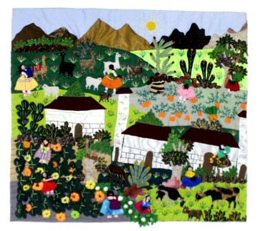
Notes:
Farm Life

Slide 6
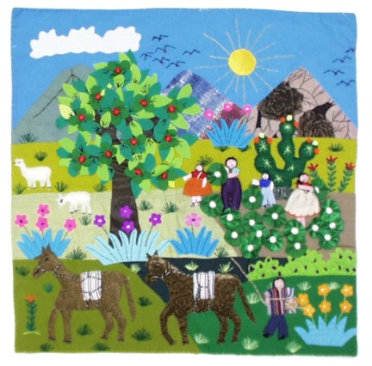

Slide 7
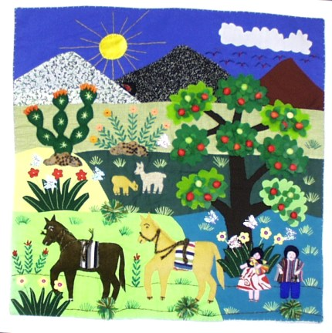
Notes:
Wedding

Slide 8
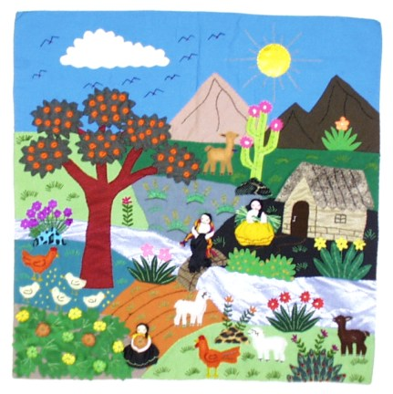

Slide 9
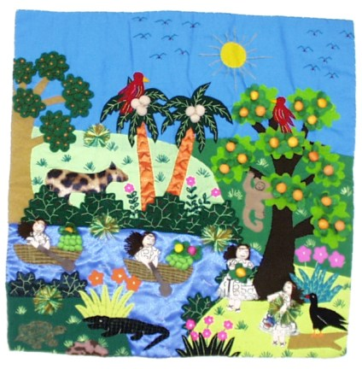

Slide 10
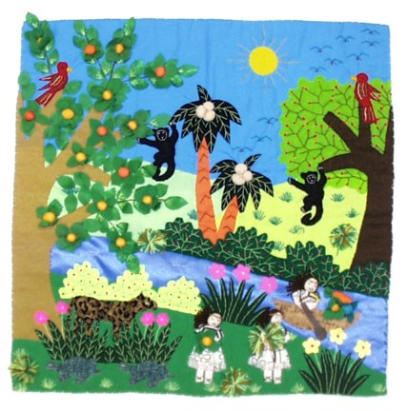

Slide 11
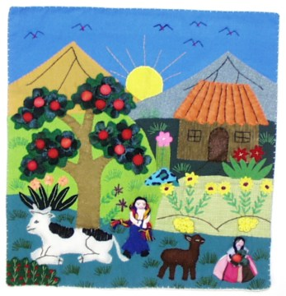

Slide 12
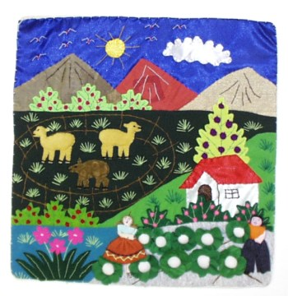

Slide 13
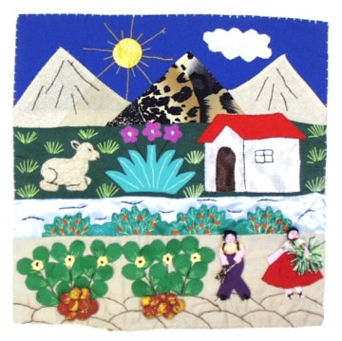

Slide 14
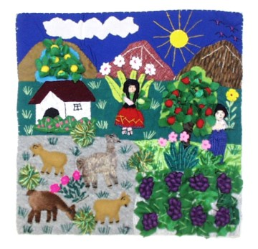

Slide 15
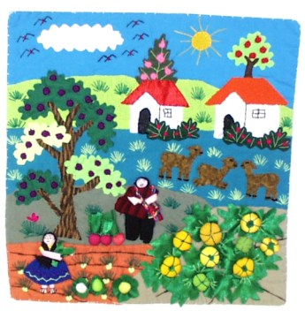

Slide 16
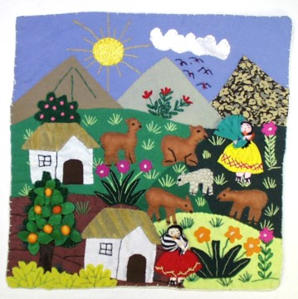

Slide 17
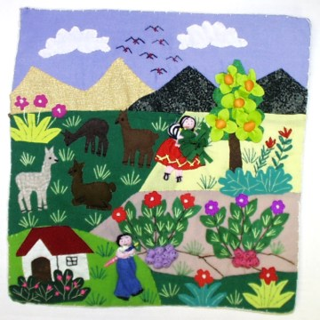

Slide 18
