Slide 1
Debi Hubbs
http://stores.ebay.com/ARTBLOOMS-STUDIO-Artist-Debi-Hubbs

Slide 2
Debi Hubbs is a popular artist and illustrator known for a whimsical style. Her art can be found in many different venues worldwide. From fun art to fine art.
A really fun site to visit…..it has Debi Hubbs art tips
http://artblooms.net/category/art-tips/

Slide 3
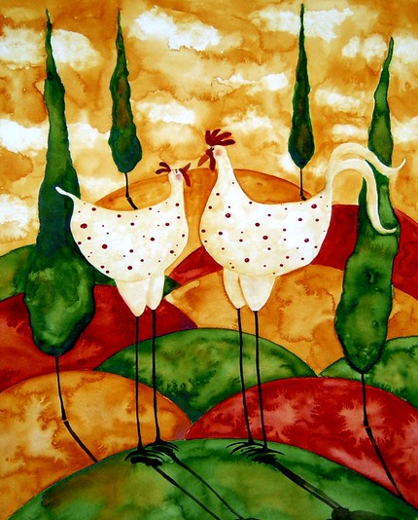
Notes:
Lovesick

Slide 4
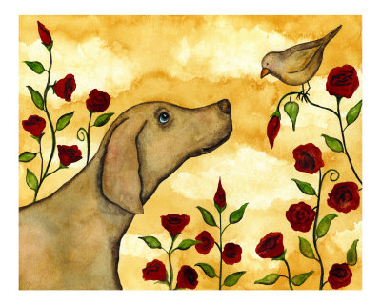
Notes:
Bird Dog

Slide 5
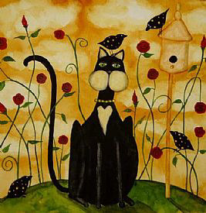
Notes:
The Hunter

Slide 6
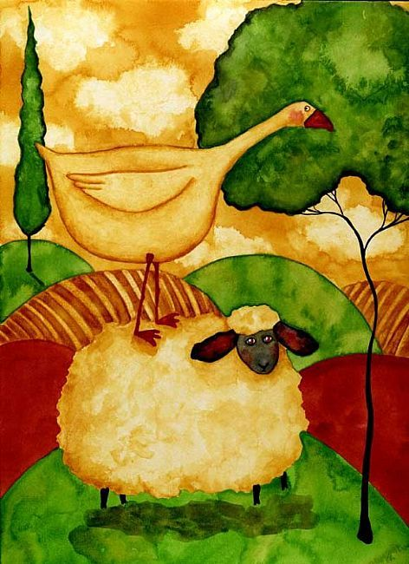
Notes:
On The Lamb

Slide 7
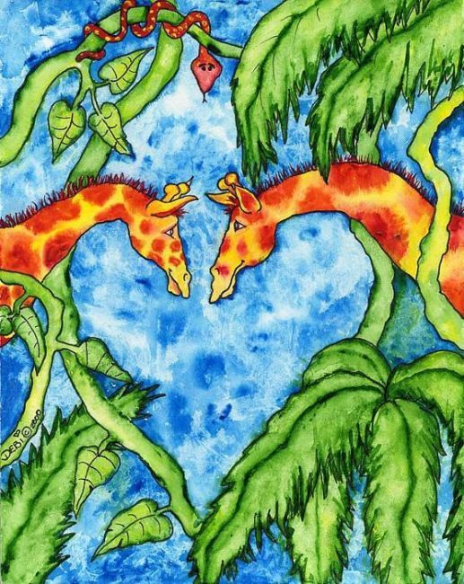
Notes:
Jungle Heat

Slide 8
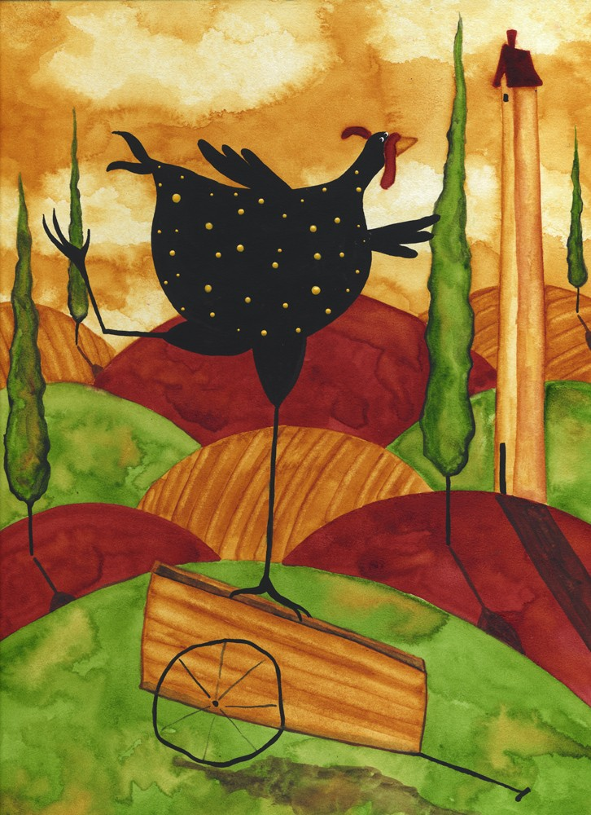
Notes:
Chicken A La Carte

Slide 9
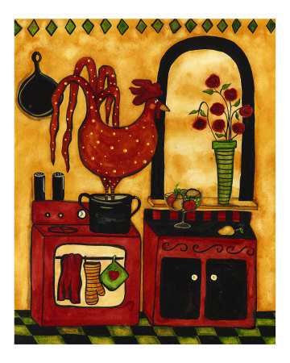
Notes:
Red’s In Hot Water

Slide 10
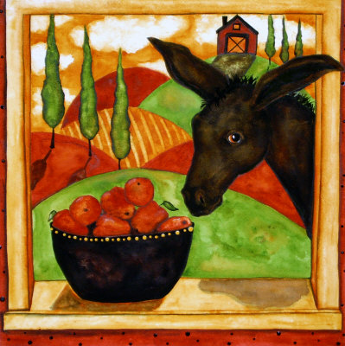
Notes:
An Apple a Day Keeps the Donkey Away

Slide 11
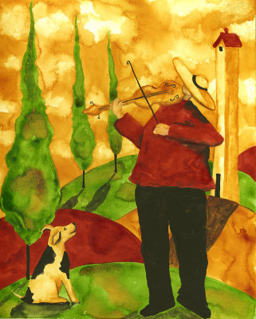
Notes:
Fiddler

Slide 12
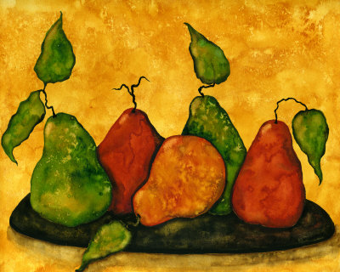
Notes:
Pears

Slide 13
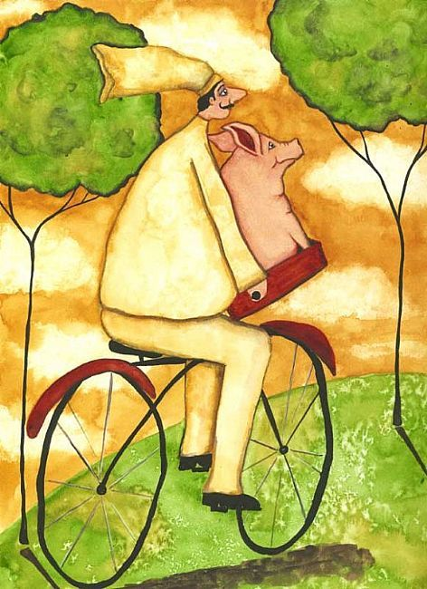
Notes:
Pierre and the Pig

Slide 14
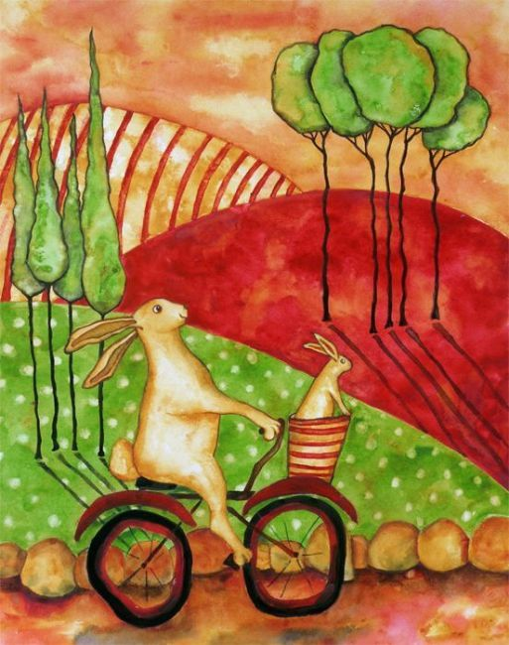
Notes:
Lillian and Her Bunny Sonny

Slide 15
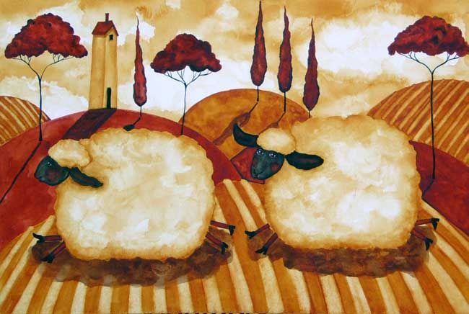
Notes:
Running Red Stockings

Slide 16
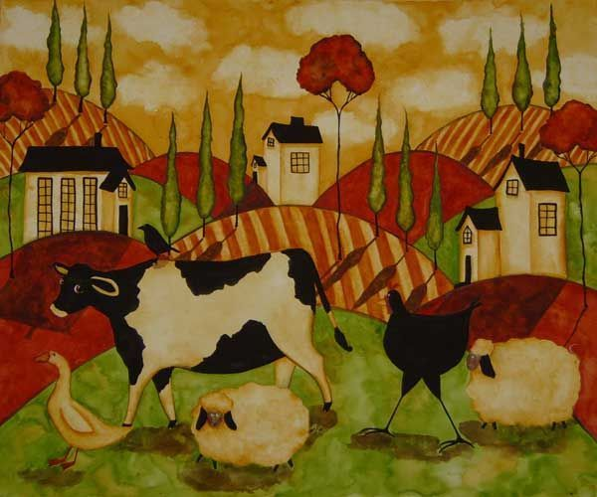
Notes:
Barnyard Brigade

Slide 17
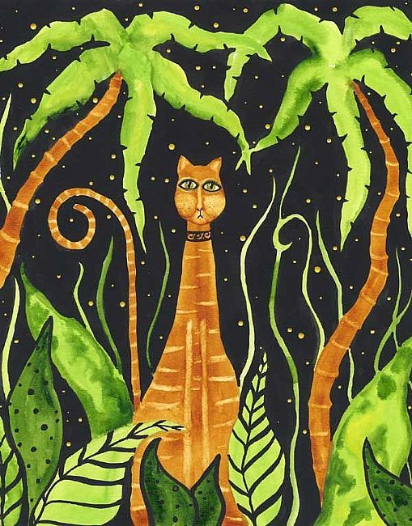
Notes:
Jungle Cat

Slide 18
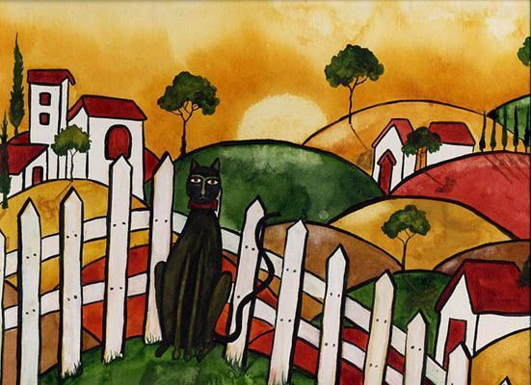
Notes:
Cat Enjoys the Sunset

Slide 19
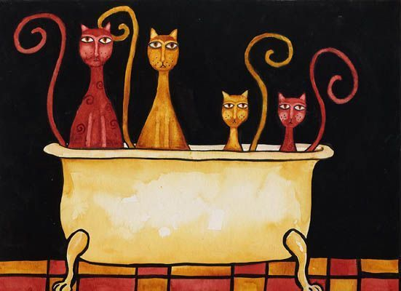
Notes:
The McFlurries Have Fleas

Slide 20
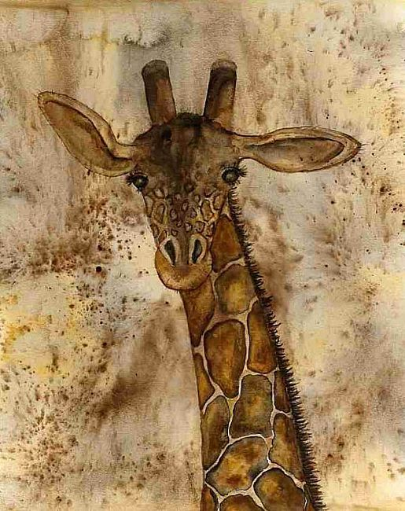
Notes:
Giraffe

