Slide 1
AMERICAN INDIAN
TOTEM POLES

Slide 2
http://www.teachervision.fen.com/native-american-history/printable/7224.html

Slide 3


Slide 4
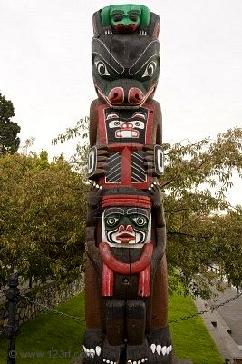

Slide 5
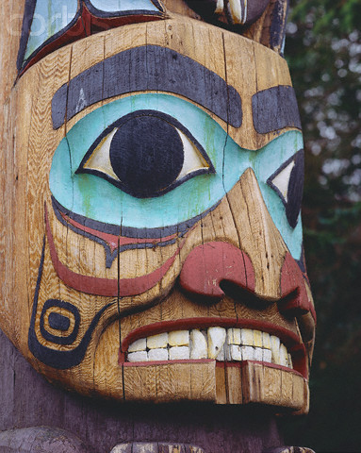

Slide 6


Slide 7
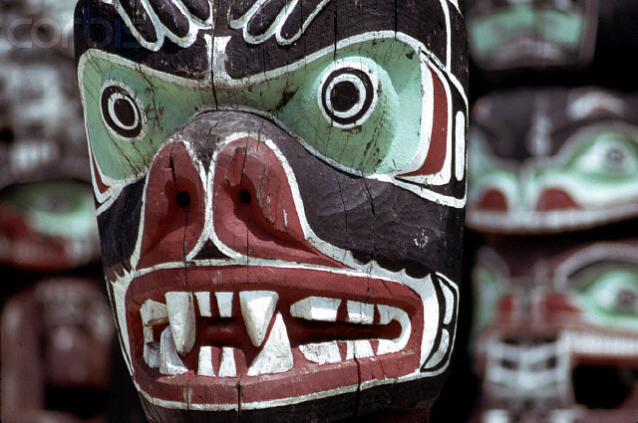

Slide 8
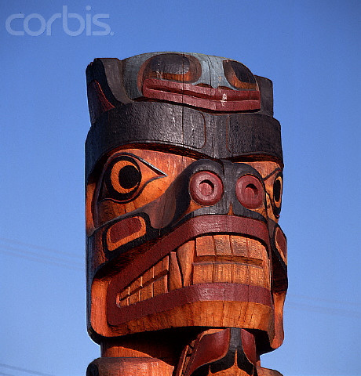

Slide 9
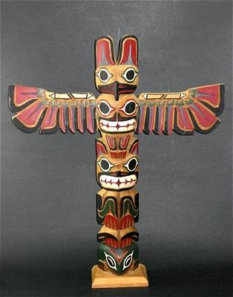

Slide 10
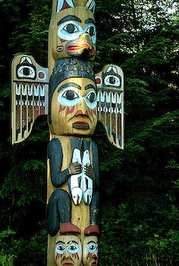

Slide 11


Slide 12
