Slide 1
Rosina Wachtmeister’s
“Cats”

Slide 2
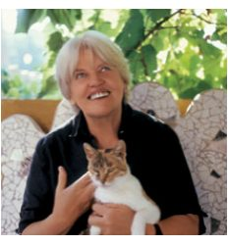

Slide 3
Born in Vienna in 1939, Rosina Wachtmeister studied art in Brazil and currently lives with her family and many animals in a picturesque village near Rome, where she works on her art, prints and posters.
Rosina Wachtmeister is world-renowned for creating distinctive art, prints and posters that are whimsical, fresh and fun.
A lover of nature, Rosina Wachtmeister has mastered the use of bright, powerful colors with playful shapes to create her art, prints and posters that captivate art and animal lovers around the world.
http://www.prints.com/art.php/Rosina_Wachtmeister/?artist_id=7671&type=6

Slide 4
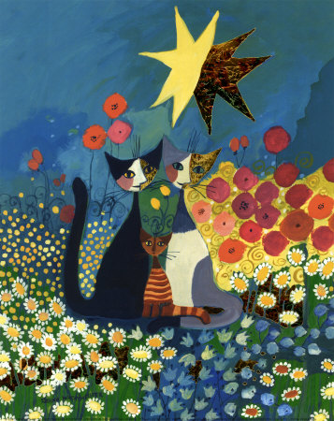


Slide 5
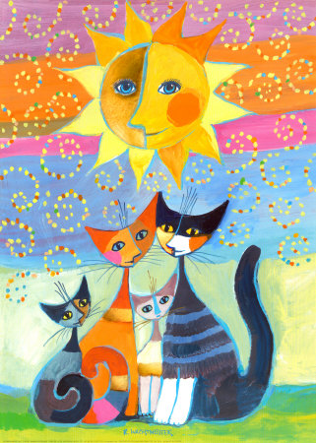

Slide 6
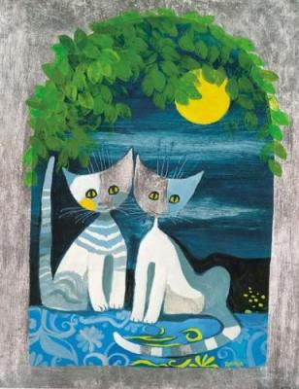

Slide 7
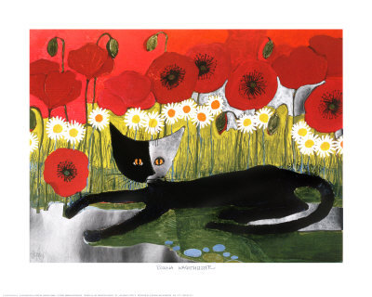

Slide 8


Slide 9
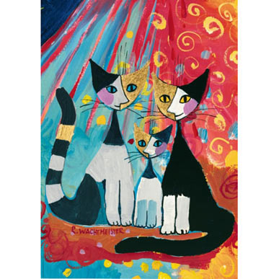

Slide 10
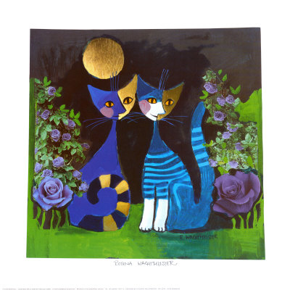

Slide 11
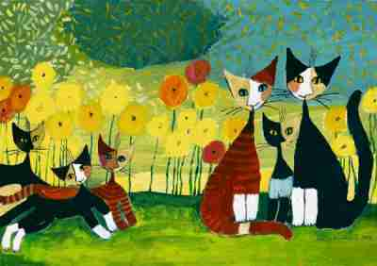

Slide 12
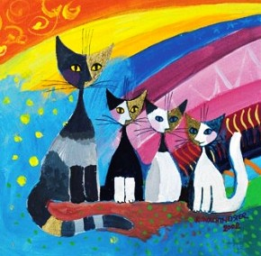

Slide 13


Slide 14
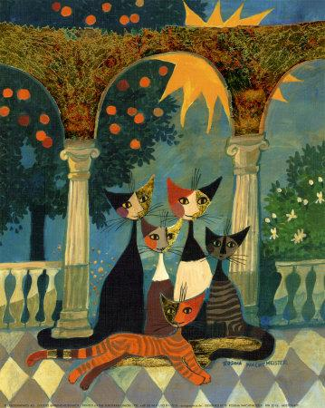

Slide 15
